Slide 1

A DEEPDIVE IN RIDESHARE PICKUP PATTERNS
By: Yuly Alcantara, Shivani Chopra, Verina Hanien, Kenny Wu

Slide 2

AGENDA
Mission
Hypothesis
Data Manipulation
Data Analysis
Key Conclusions
Next Steps
Questions

Slide 3
Our mission was to analyze publicly available rideshare data from 2014. The LYFT data sourced contained pick-ups across all of NYC, including the time and location (latitude & longitude) of the pickup.
Prior to analyzing the data, a hypothesis was created based on the fields provided. The data was transformed using excel and a RESTful API was created using Flask. A combination of HTML, JavaScript, Plotly and D3 was used to create a heatmap, cluster, marker and graphs to help visually analyze the data.

Slide 4
HYPOTHESIS
We predicted that the pickup concentration would primarily be in the evenings, between 9:00PM - 11:59PM, in hot spots such as Greenwich / East Village and Union Square.

Slide 5
DATA MANIPULATION
The original dataset for FY 2014 LYFT pickups was more than 250K rows, which was too lengthy for our purposes
Upon further evaluation, one day’s worth data from Friday, September 5th was utilized for our purposes
This helped condense our dataset to just ~5.7K rows, which was more manageable
Friday data was chosen to better understand rideshare activity during peak recreational times
The data cut was done on Excel and a CSV was utilized to create the RESTful API

Slide 6
DATA ANALYSIS
In order to better understand the data, the following visualizations were chosen:
Heatmap
Clusters
Markers
Charts
Pickups by Hour
Pickups by Hour Grouping (every 3 hours)

Slide 7
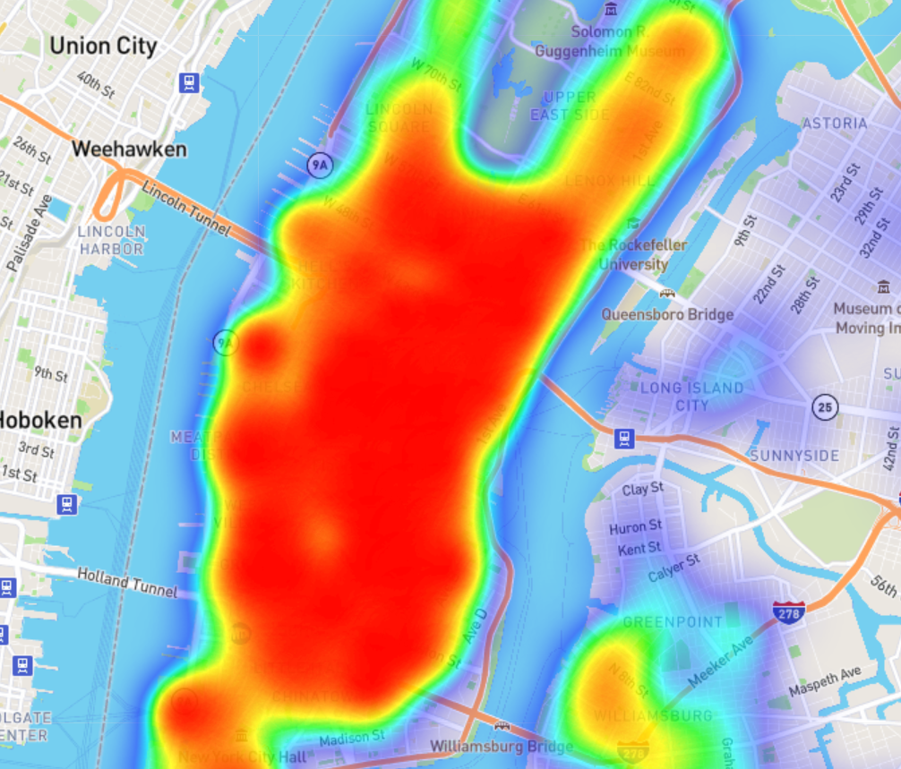
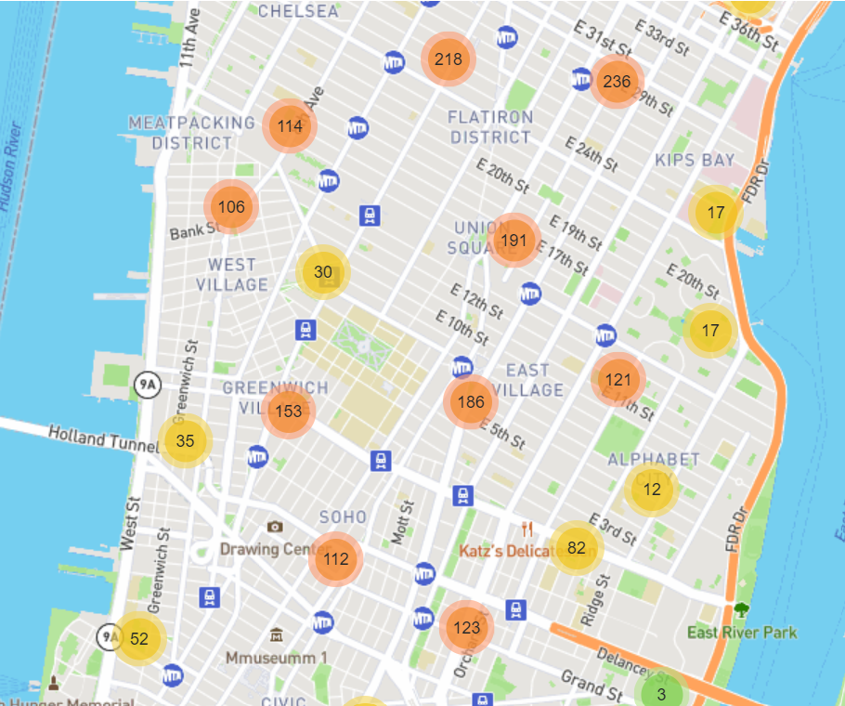
KEY OBSERVATIONS ¹
Ride pickups are primarily in Manhattan, midtown and below
Clusters reflect that there’s a greater concentration of pickups in Greenwich Village and Midtown West
Based on public LYFT data from September 5, 2014

Slide 8
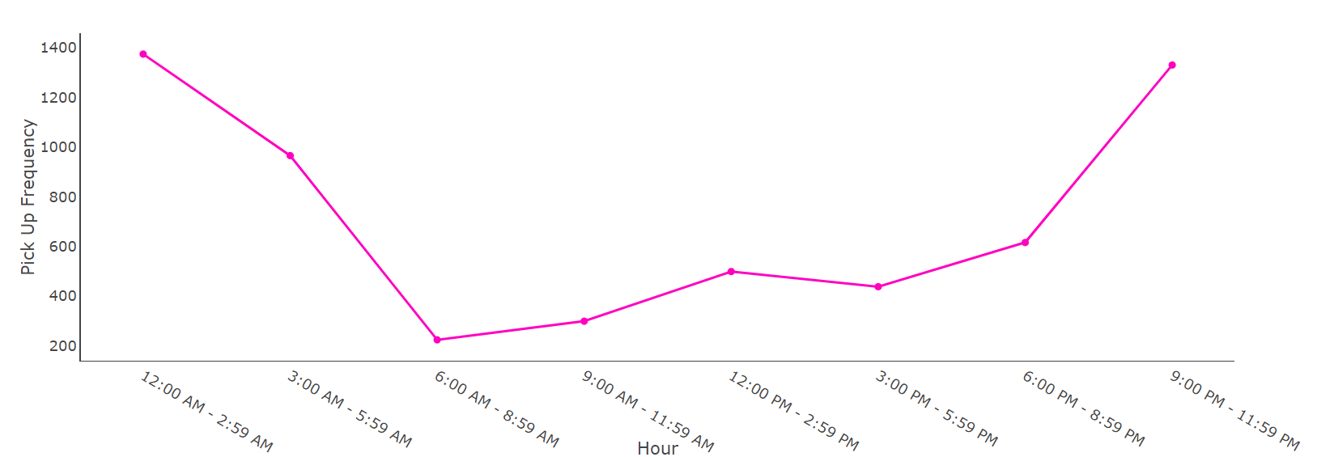
KEY OBSERVATIONS (cont’d) ¹
Significant decline in pickups between 6:00 AM - 8:59 AM, likely due to:
Friday WFH days
Delayed morning commuter traffic
Predicted peaks from 12:00 AM - 2:59 AM & 9:00 PM - 11:59 PM
Thursday HH likely drove the 12:00 AM - 2:59 AM pickup traffic
Friday night rendezvous in the city drove evening pickups
Based on public LYFT data from September 5, 2014

Slide 9
Next Steps & Conclusions
If we had more time, we would have looked in to the following:
Comparing LYFT pickups to UBER across the same geo-locations
Analyzed advantage of market share
Better assessed supply - demand across neighborhoods based on a more comprehensive rideshare dataset
Further analyzing LYFT data:
Comparison of hour grouping data across all days of the week
Distribution of daily pick up volume across weekdays, weekends and holidays

Slide 10

THANK YOU!
ANY QUESTIONS?

